Slide 1

Adult Income
Presented by
Derek Overton
February 13, 2013

Slide 2
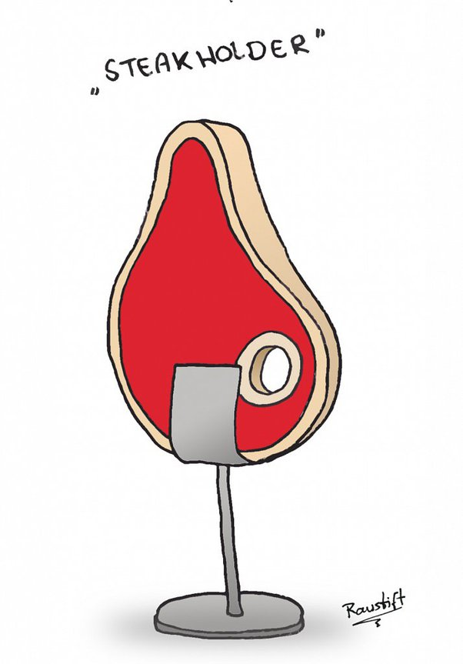
An individual’s annual income results from various factors. Intuitively, it is influenced by the individual’s education level, age, gender, occupation, and etc.
My stakeholders for this project are the Guaranteed Basic Income Project also known as (GBIP)
The prediction task is to determine whether a person makes over $50K a year.

Slide 3
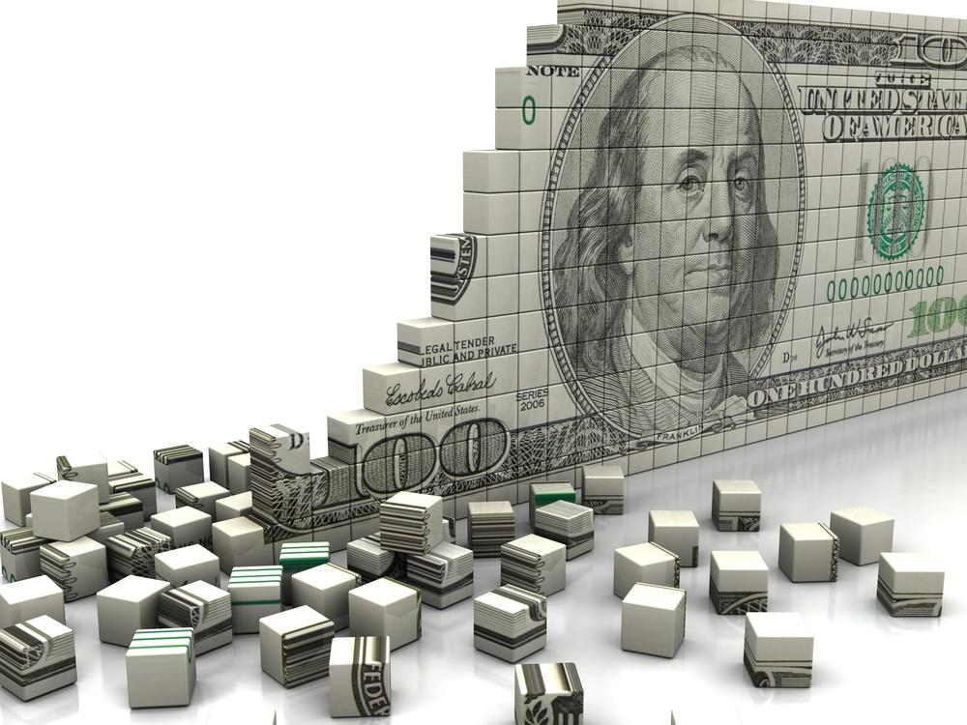
Adult Income Data Information
The data was extracted from the 1994 Census bureau database by Ronny Kohavi and Barry Becker (Data Mining and Visualization, Silicon Graphics.
Below is the linked to the data set:
https://www.kaggle.com/datasets/wenruliu/adult-income-dataset

Slide 4
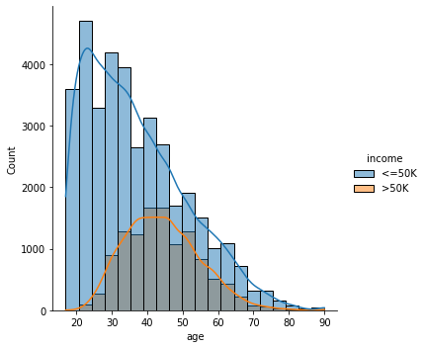
Income Greater than $50K and Less than or Equal to $50K
Observation:
- People who earn more than 50K tend to be between the ages of 35 and 55.
- Most people with incomes under 50K are between the ages of 17 and 35.

Slide 5
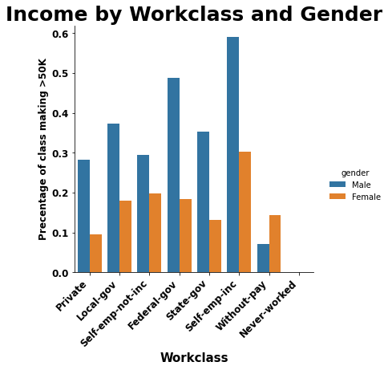
Income by Working Class and Gender
The first Trend that is recognized is Income by Workclass and Gender
- The decimals represent the percentage of Work Class and Gender making greater than 50K.
- The trend is that most people are choosing to work as Self-emp-inc. This is most likely because they are business owners.
- The females in the Without-pay category is believed to earn income by other means such as child support and spousal support.

Slide 6

Information for Consideration by Stakeholders
This dataset not balance , i.e. 76% of them are belong to income group 1 (who earns more than 50k) and 23.93% fall under the income group 0 (who earns less than 50k).
Females have more flexible working hours per week in the income groups who earns <=50k.
Males have more flexible working hours per week in the income groups who earns >50k.
The Median "age" of Females who earn greater than 50k has age difference of 2-3 years(lower) than the Median "age" of males who earn greater than 50k.
Generally people can be seen working for 30 hours to 40 hours per week.
Income group who earns >50k have flexible working hours.
For "female" earning more than 50k is rare with only 3.62% of all observations.
But for male, 20.31% of all people earn more than 50k .
self-emp-inc workclass is only where more people earn >50k(belong to income group 1).
People having degree doctorate,prof-school,masters are making salary more than 50K(it can be concluded that higher education means more salary).

Slide 7

Final Recommendation
Overall, after paramter tuning on my Logistic and KNN Model, Random Forest appears to have the best model score (86%). The dataset is heavily white-based, it only can present the white-community not for the entire group in north america the dataset is collected in 1994, the level of influence for each feature maybe changed during these days.
More research and analysis on exploratory data analysis should be conducted to explore more detailed relationships (for example, classification analysis between income level and each occupation, regression analysis between age and capital-gain/loss etc). Although this Model has 86% accuracy score its perdictions are skewed. My recommendation would be to get a more current dataset from which to build a model from that would be more reflective of today's society.

Slide 8





Questions?

